Slide 1
Workplace Mental Health
By: Jesse Hassan
October 26, 2023

Slide 2
Mental Health At Work

Slide 3
What Does the Data Say
Oct ‘22 U.S. Surgeon General Office’s 1st EVER framework for “Workplace Mental Health and Well-Being”
American Psychological Association (APA) 2023 results in table.
55% of workers believe that their employer thinks their workplace is healthier than it is.
43% worry if they told their employer of a mental health concern it would negatively impact them.
77% of workers report workplace related stress in the last 30 days.
Employee Values | Very | Somewhat
Well-Being | 57% | 35%
Employer Mental Health Support | 52% | 40%
Feel Respected | 66% | 29%
Work/Life Balance | 61% | 34%

Slide 4
Toxic Workplace Report

Slide 5
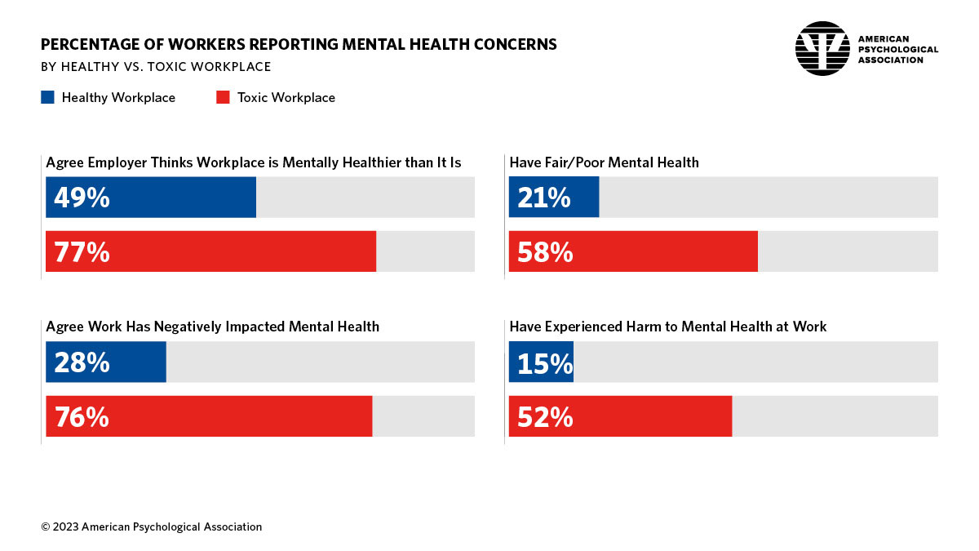
Reporting Mental Health Concerns

Slide 6
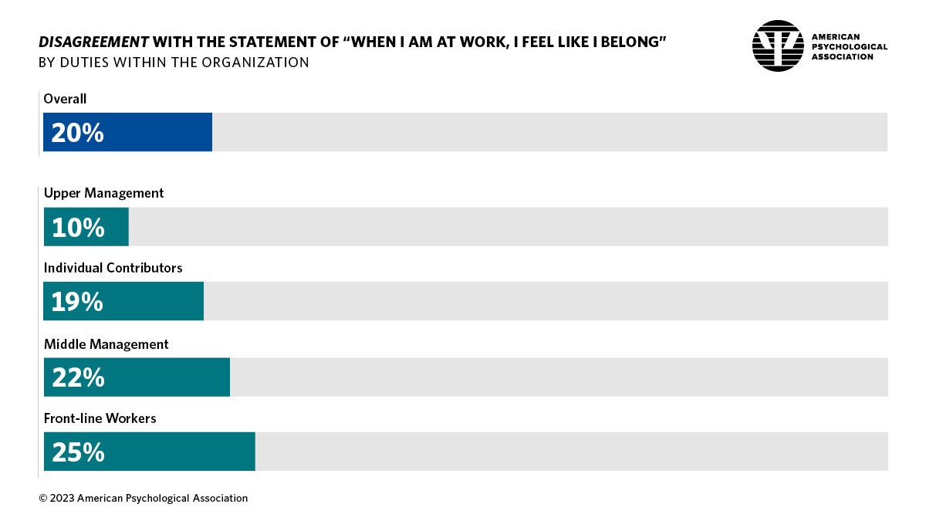
Feelings of Not Belonging At Work

Slide 7
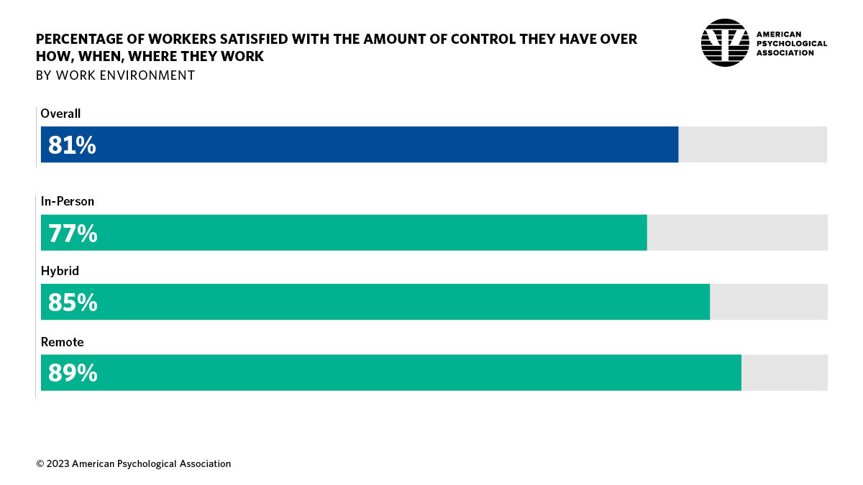
Satisfaction with Control Over Work

Slide 8
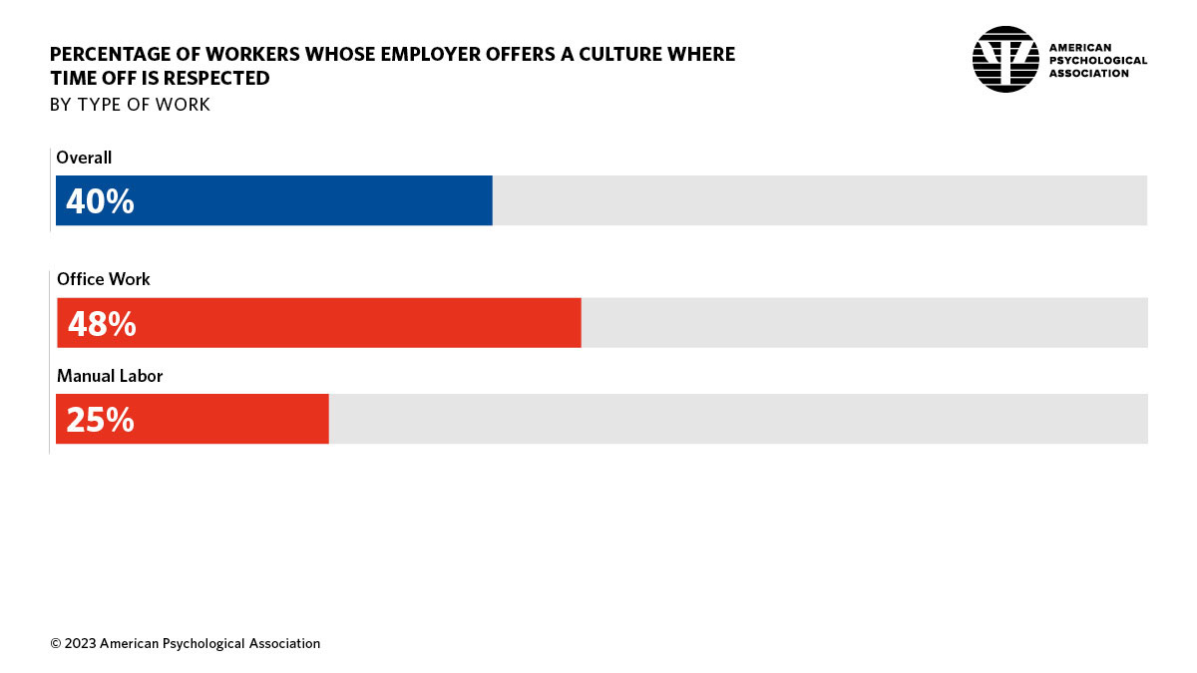
Employer Respects Time Off

Slide 9
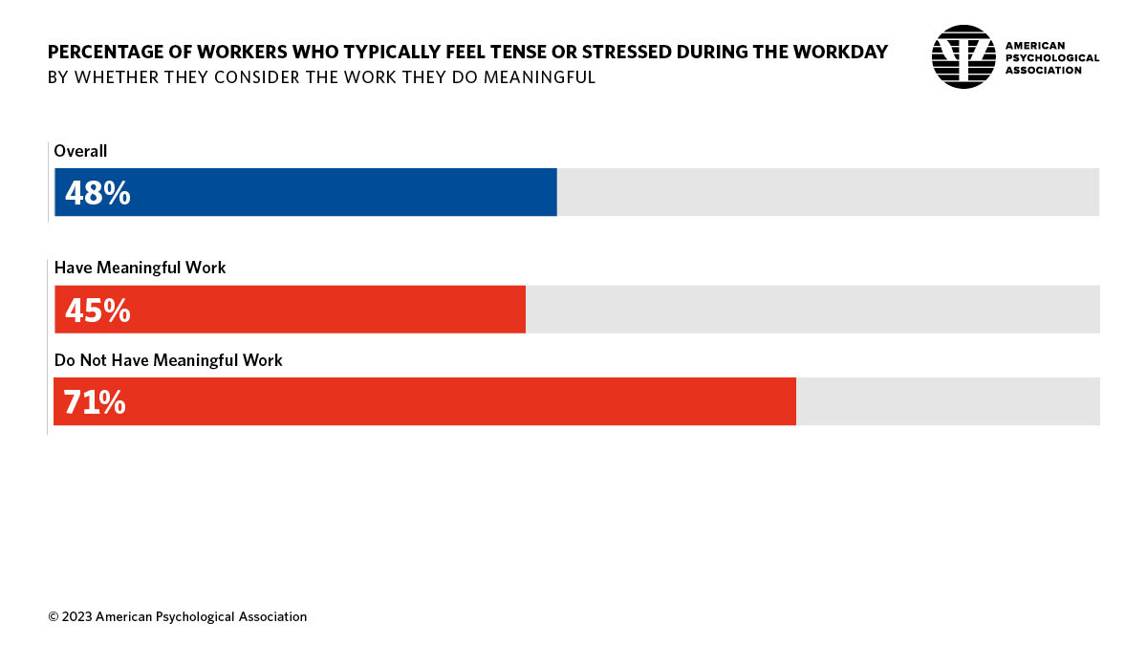
Stress – Meaningful Work

Slide 10
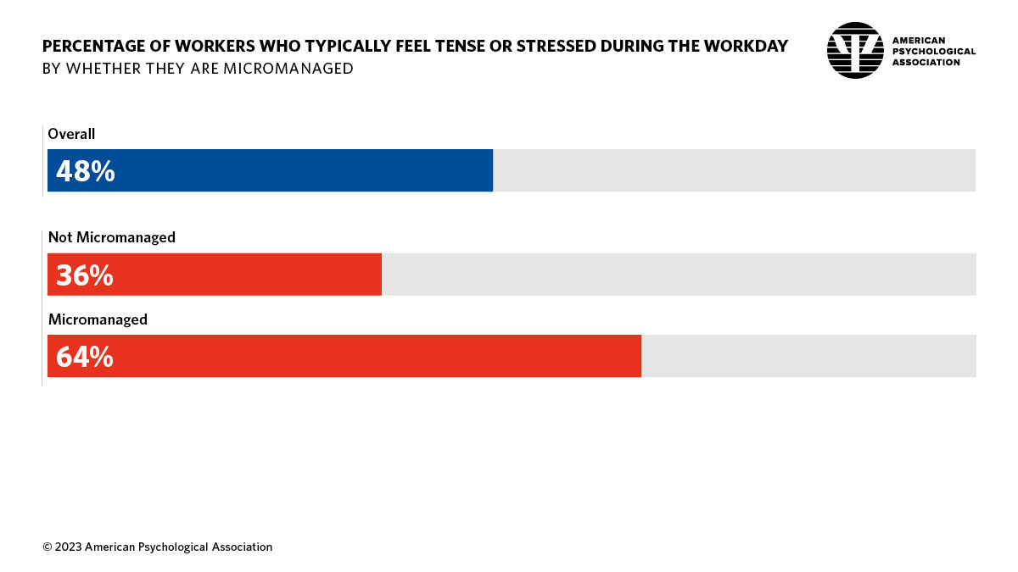
Stress –Micromanaged

Slide 11
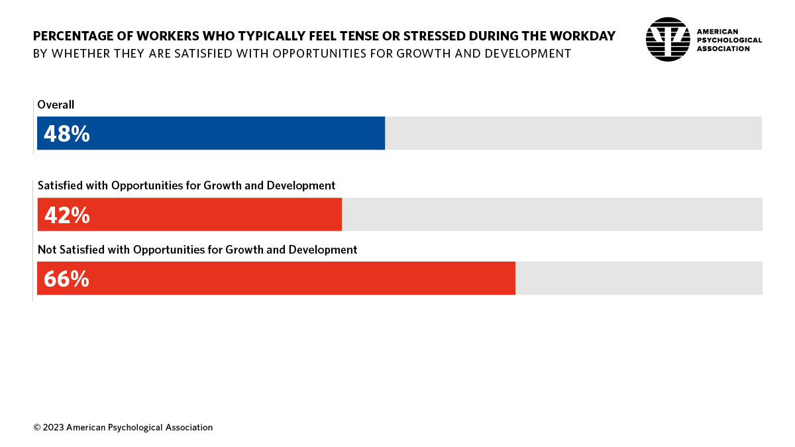
Stress – Opportunities for Growth/Development

Slide 12
Workplace Mental Health Supports
Only 43% reported that their employer offers health insurance with coverage for mental health and substance use disorders.
Only about one-third (35%) reported that their employer offers a culture where breaks are encouraged.
Only 29% reported that their employer offers an employee assistance program.
Only 21% reported that their employer offers meeting-free days.
Only 17% reported that their employer offers 4-day work weeks.
Only 15% reported that their employer offers company-wide mental health days.
Only 12% reported that their employer has people on-site who have received mental health training.

Slide 13
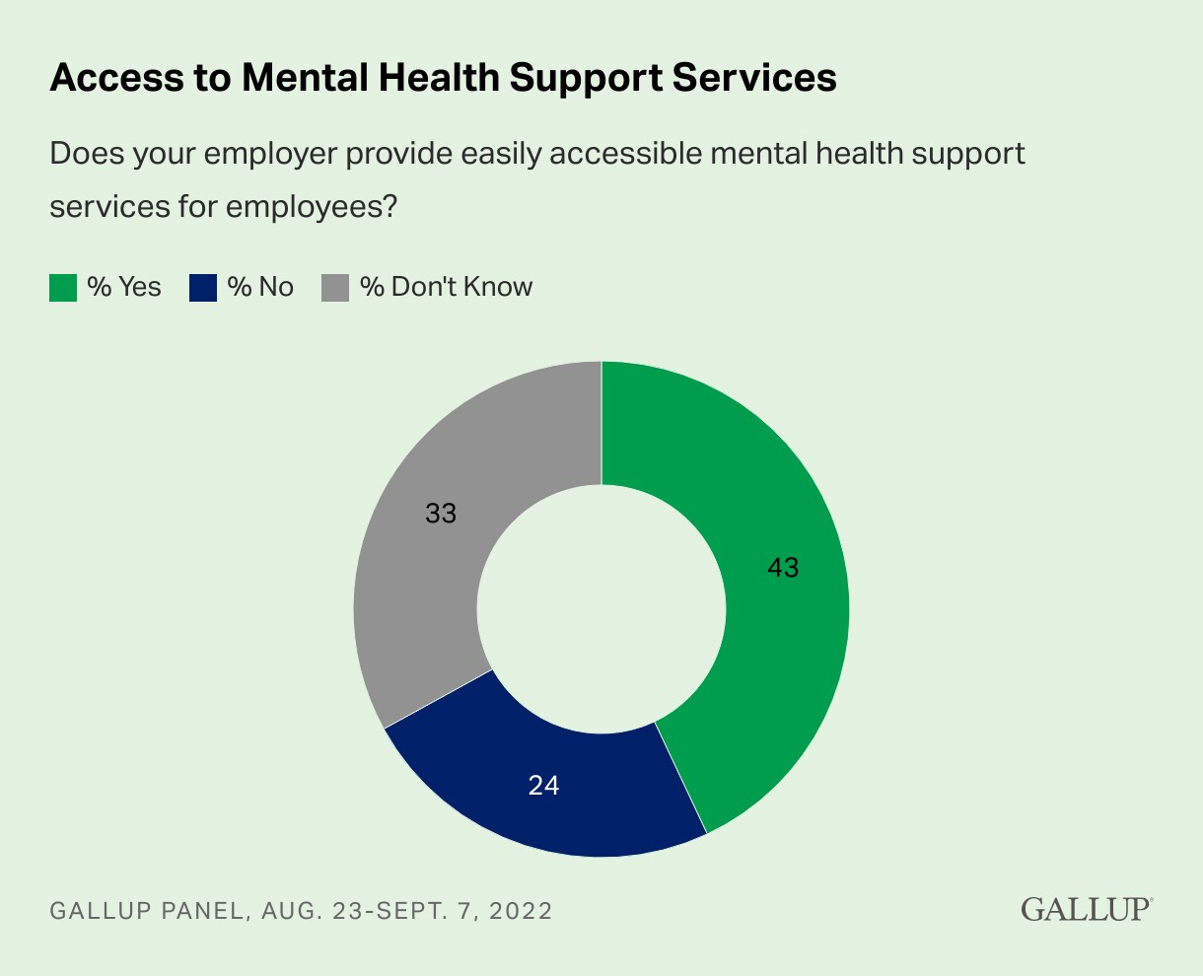
Workplace Mental Health Supports
Does your Employer provide an Employee Assistance Program (EAP)?

Slide 14
Five Workplace Essentials
Protection from harm (including security and safety)
Connection and community (including social support and belonging)
Work-life harmony (including autonomy and flexibility)
Mattering at work (including dignity and meaning)
Opportunity for growth (including learning and accomplishment)
APA’s 2023 Work in America Survey tracks the surgeon general’s five essentials, as well as the central core principles of worker voice and equity, all with an eye toward promoting an equitable, productive, and psychologically healthy future of work.

Slide 15
Awareness
Promote strategies to help employees increase their mental health and wellbeing.
Offer employees stress management training to develop relaxation, mindfulness, and resiliency skills.
Create a work environment that uses natural light, plants, etc., and provide a versatile, flexible range of spaces.
Foster communication skills and emotional intelligence among managers and supervisors.
Train managers and supervisors to recognize and respond to warning signs.
Inform employees of available resources such as free relaxation APPs or the company Employee Assistance Program (EAP).
Develop and implement anti-bullying policies.
Sponsor awareness-building and anti-stigma campaigns.

Slide 16
Accommodations
Allow sick leave for reasons related to mental health, and flexible use of vacation time.
Offer additional unpaid or administrative leave for treatment or recovery and/or leaves of absence.
Allow use of brief, flexible leave (a few hours at a time) for therapy and other related appointments.
Provide breaks according to individual needs rather than a fixed schedule, more frequent breaks, and/or greater flexibility in scheduling breaks.
Permit beverages and/or food at workstations, if necessary, to mitigate the side effects of medications. Welcome on-site job coaches.

Slide 17
Assistance
Provide mentoring, coaching, and peer support to your employees.
Make flexible work arrangements such as flex scheduling and telecommuting available to all employees, as a form of proactive accommodation.
Offer stress management training.
Provide access to mental wellness screening and treatment options.
Offer fitness programs to improve employees’ physical health, which in turn promotes positive mental health.

Slide 18
Access
Assess your health plan’s coverage for mental health treatment, including inpatient treatment options and medication coverage.
Give employees easy access to mental health support and care, e.g., an Employee Assistance Program (EAP).
Encourage mental health and stress management through a comprehensive wellness and health promotions program.
Provide case management services to facilitate timely return to work for those who have experienced absences due to mental health concerns.
Comply with the Mental Health Parity and Addiction Equity Act.

Slide 19
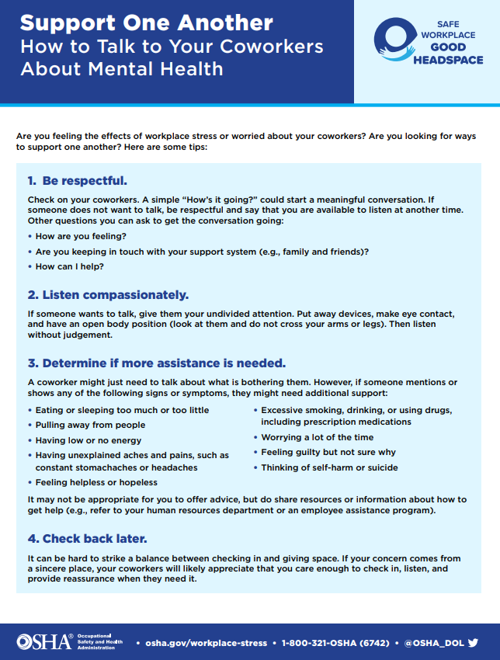
Support One Another

